Slide 1
Data Structure Visualization
Team members:
- Benjamin Kuo
- Aman
Interactive animations powered by p5.js

Slide 2
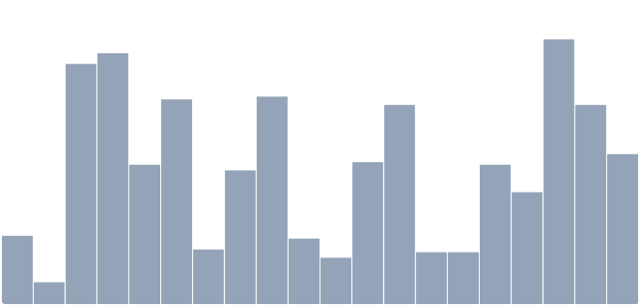
Outline
⟐ Problem Statement
⟐ Project Overview
⟐ Module Breakdown
⟐ Demonstration
⟐ Design Highlights
⟐ Future Extensions

Slide 3
Problem Statement
Why Understanding Data Structures Is Difficult ?
State changes are invisible.
Students cannot see how operations (push, pop, insert, compare, swap) update internal structures.
Static diagrams can’t show dynamics.
Traditional materials fail to represent step-by-step behaviors such as pointer movement or traversal paths.

Slide 4
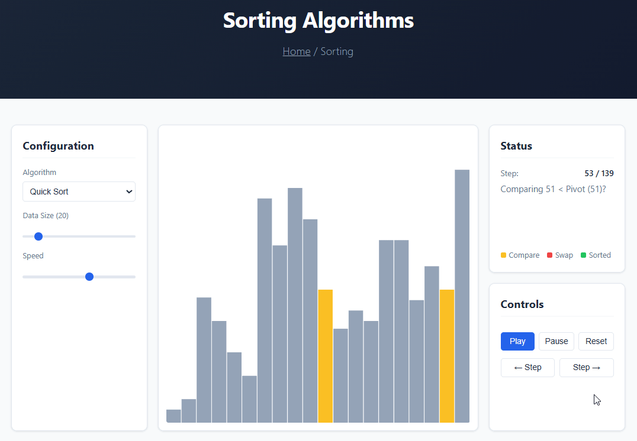
Problem Statement
Solution
Make it move.
Visual steps reveal the logic instantly.

Slide 5
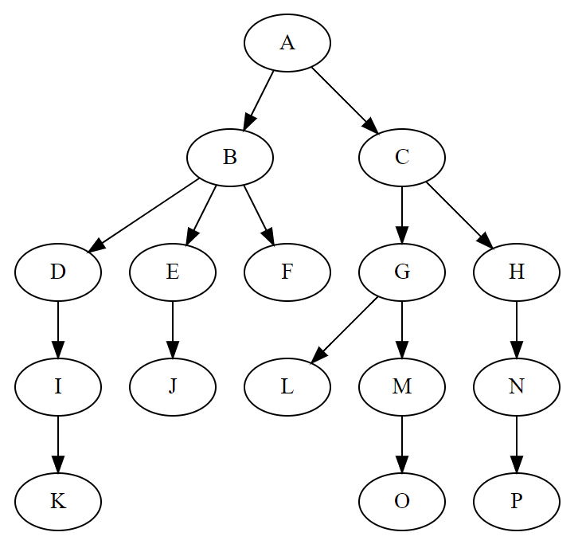
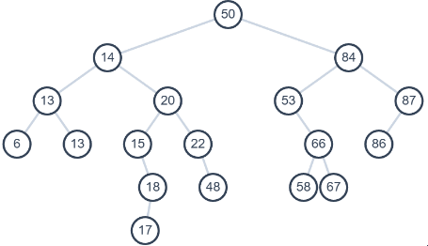
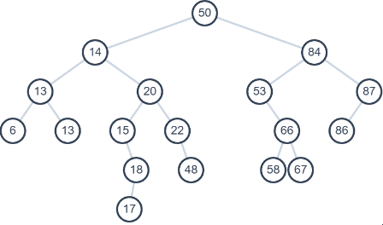
Problem Statement
Before
After
Pre-order:
Post-order:
Pre-order:
A B D I K E J F C G L M O H N P
Post-order:
K I D J E F B L O M G P N H C A

Slide 6
Project Overview
Data structure/
├── assets/
│ ├── css/
│ │ ├── style.css
│ │ └── visualizer.css
│ ├── image/
│ │ └── showcase.gif # Demonstration gif
│ └── js/
│ ├── core/
│ │ ├── AnimationStep.js
│ │ └── Visualizer.js
│ └── modules/
│ ├── basic/
│ │ ├── Queue.js
│ │ └── Stack.js
│ ├── searching/
│ │ ├── BinarySearch.js
│ │ └── LinearSearch.js
│ ├── sorting/
│ │ ├── BubbleSort.js
│ │ ├── MergeSort.js
│ │ └── QuickSort.js
│ ├── tree/
│ │ └── BST.js
│ └── utils/
│ ├── helpers.js
│ └── p5.min.js # p5.js library
├── pages/
│ ├── basic.html
│ ├── searching.html
│ ├── sorting.html
│ └── tree.html
├── index.html # Main webpage
├── LICENSE # MIT license
└── README.md # Project documentation
Page Overview
Index (main navigation hub)
├── Basic Structures (Stack · Queue)
├── Searching (Linear · Binary)
└── Tree Structures (BST)

Slide 7
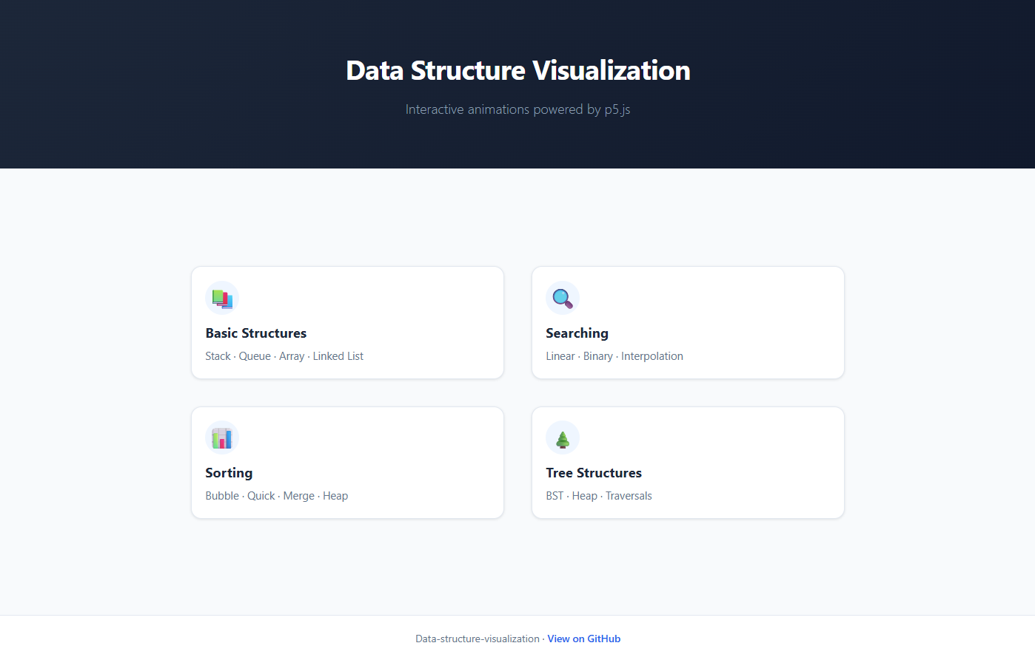
Project Overview

Slide 8
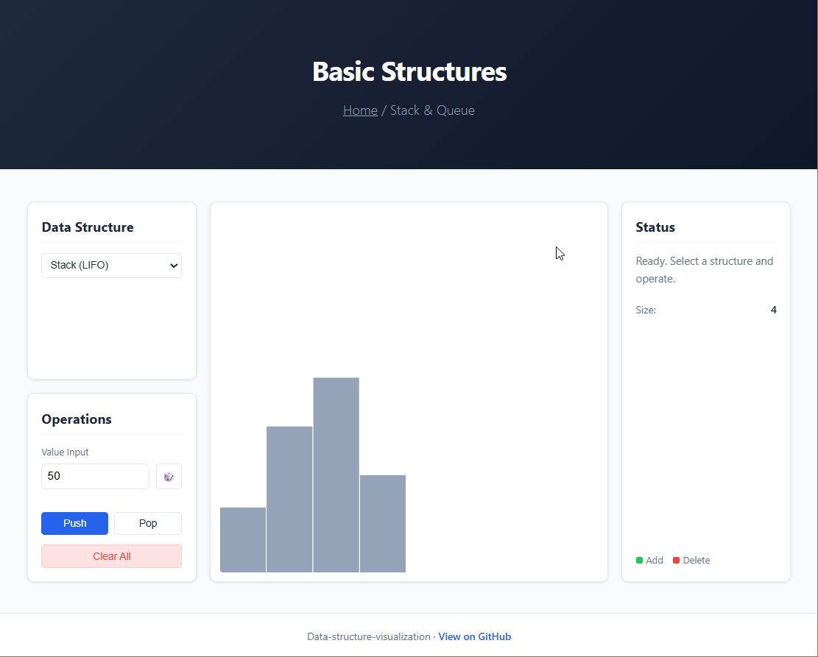
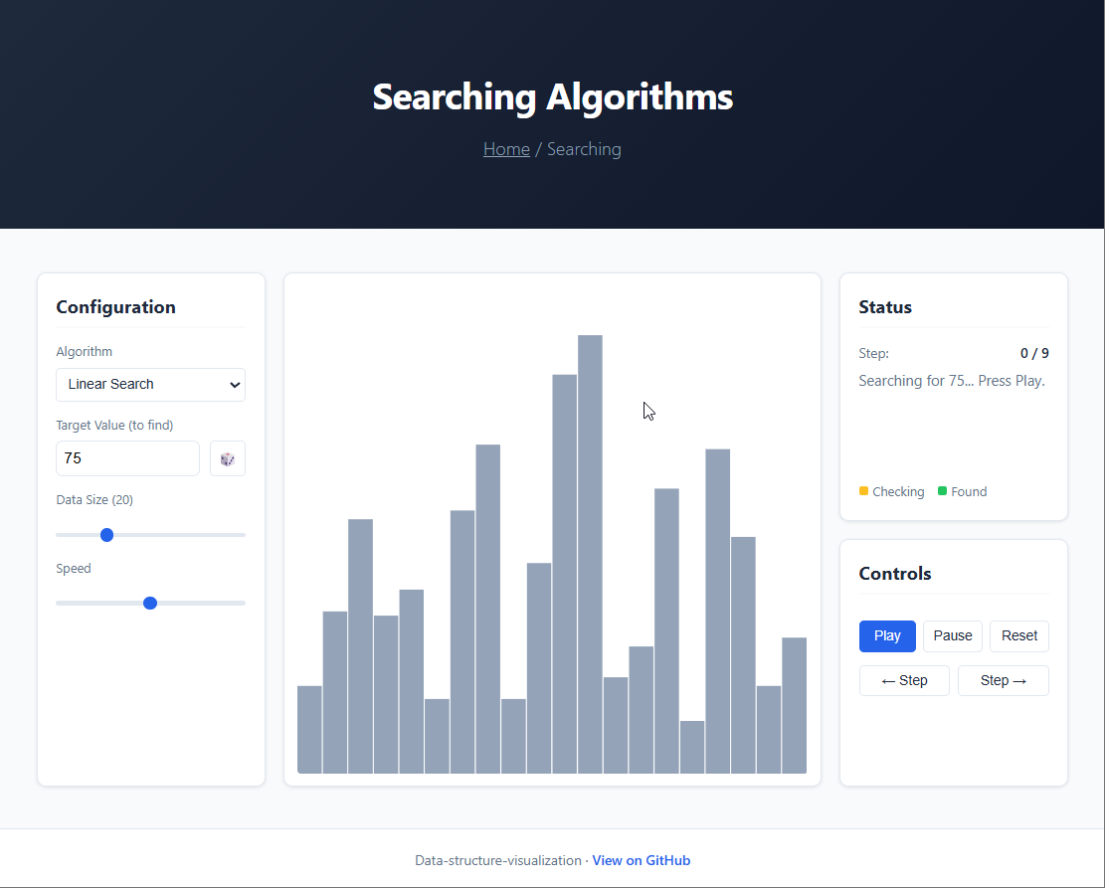
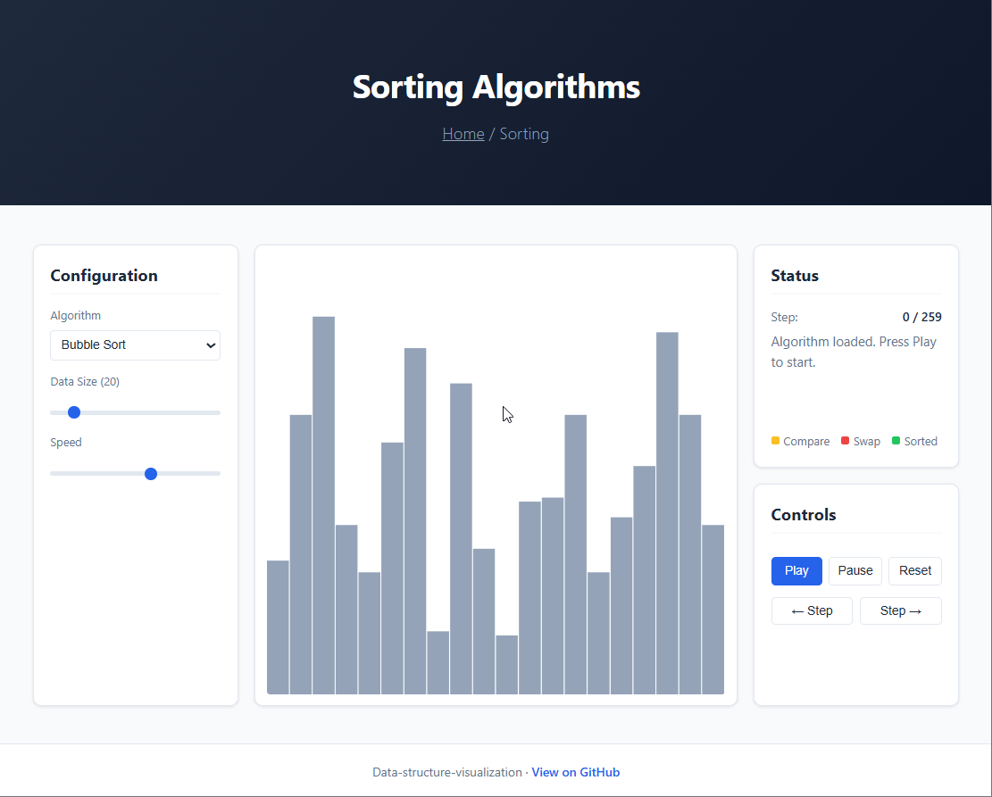
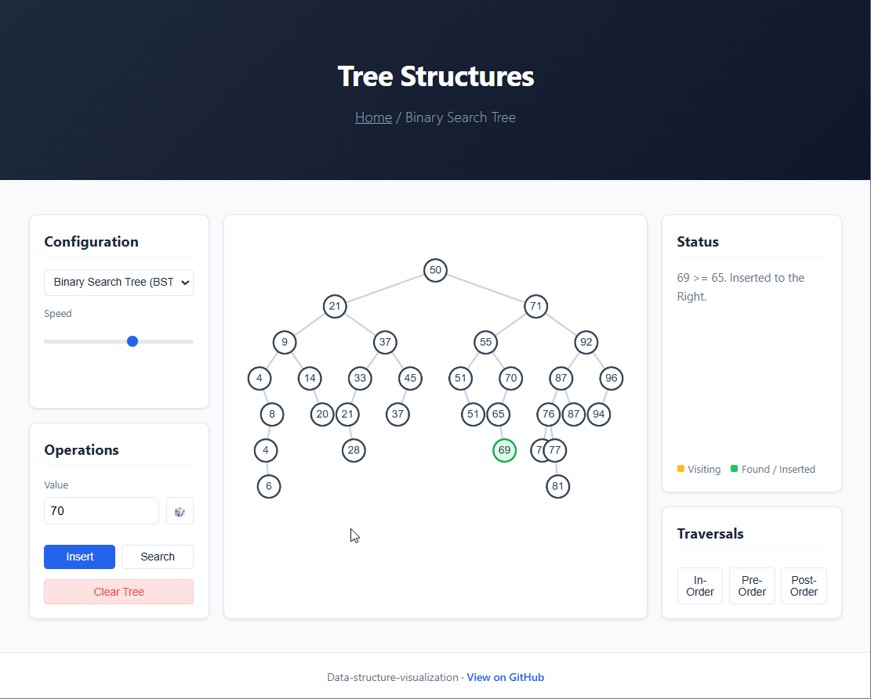
Project Overview

Slide 9
Module Breakdown
Basic Structures
Stack (LIFO)
Elements are added and removed from the top.
Queue (FIFO)
Elements enter from the back and exit from the front.
Basic Structures

Slide 10
Module Breakdown
Searching
Linear Search
Checks each element one by one.
Binary Search
Repeatedly halves the search range on a sorted array.
Searching

Slide 11
Module Breakdown
Sorting
Bubble Sort
Repeatedly compares and swaps adjacent elements.
Quick Sort
Uses a pivot to partition the array.
Merge Sort
Divides the array, then merges sorted halves.
Sorting

Slide 12
Module Breakdown
Tree Structures
Binary Search Tree (BST)
Values smaller go left, larger go right.
Traversals
Supports Pre-order, In-order, and Post-order.
Tree Structures

Slide 13
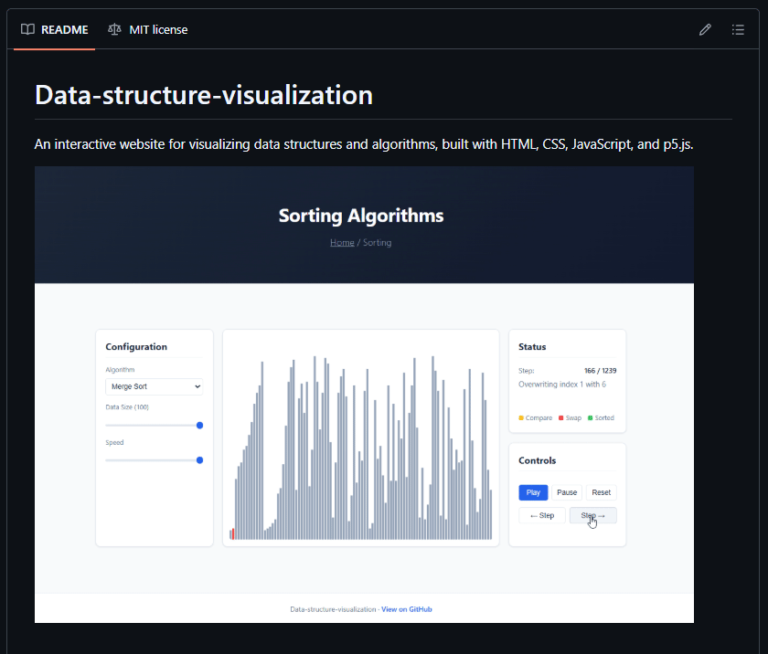

Demonstration
Visit the website:
https://benjikuo.github.io/Data-structure-visualization/

Slide 14
Design Highlights
Key Design Features
Consistent Layout
Color-Coded States
Interactive Controls
Real-Time Visualization
Modular Architecture

Slide 15
Future Extensions
Future Improvements
More Algorithms
Add Heap Sort, Shell Sort, and other modules.
Add Tree Structures
Support AVL and Red–Black Trees with rotation animations.
Hash Table Visualization
Show hashing, collisions, and probing strategies.
Graph Algorithms
Visualize BFS, DFS, Dijkstra, and MST on a graph canvas.

Slide 16

Thank You

